Slide 1

Reliance Industries Stock Forecast
MENTOR NAME: Neha Ramchandani PROJECT - 4

Slide 2
Team Members
Mr. Vaibhav Narayan Rakhunde
Ms. Vaishnavi Ravindra Patil
Ms.Akshaya Gunuganti
Ms.Jui Kulkarni
Mr.Vandanapu Srihari
Mr.Dnyanesh Durgesh Mahajan

Slide 3
Business Problem:
Stock Forecast
Objective:
Predict the Reliance Industries Stock Price for the next 30 days.
There are Open, High, Low, and Close prices that you need to obtain from the web for days starting from 2000 to 2022 for Reliance Industries stock.
Split the last year into a test set- to build a model to predict stock price.
Find short-term, & long-term trends.
Understand how it is impacted by external factors or any big external events.
Forecast for next 1 year.

Slide 4
Project Architecture / Project Flow
Exploratory data analysis (EDA)
Model Building
Deployment

Slide 5
Data set Details:
https://finance.yahoo.com/quote/RELIANCE.NS/history?period1=946684800&period2=1691452800&interval=1d&filter=history&frequency=1d&includeAdjustedClose=true
Date | Open | High | Low | Close | Adj Close | Volume
03-01-2000 | 36.74746 | 38.94457 | 36.74746 | 38.94457 | 29.68419 | 28802010
04-01-2000 | 39.98124 | 42.0623 | 38.88268 | 42.0623 | 32.06058 | 61320457
05-01-2000 | 39.71046 | 44.54566 | 39.71046 | 43.71014 | 33.31659 | 1.73E+08
06-01-2000 | 44.71586 | 46.52615 | 44.71586 | 45.54364 | 34.71412 | 1.01E+08
07-01-2000 | 45.64421 | 49.18744 | 45.33476 | 48.66911 | 37.0964 | 1.28E+08
10-01-2000 | 49.11008 | 49.31122 | 47.23789 | 47.73301 | 36.38289 | 86714866
11-01-2000 | 47.64792 | 48.1121 | 43.91902 | 44.63849 | 34.02419 | 81074352
12-01-2000 | 44.71586 | 47.19148 | 43.65598 | 46.68088 | 35.58094 | 78264129
13-01-2000 | 47.3462 | 48.95535 | 47.05222 | 48.25135 | 36.77797 | 1.1E+08
14-01-2000 | 47.88774 | 49.76767 | 47.88774 | 48.93988 | 37.30279 | 86996234
17-01-2000 | 49.2416 | 49.96107 | 47.50866 | 47.7717 | 36.41237 | 69343031
18-01-2000 | 47.81038 | 49.3499 | 47.27657 | 48.61496 | 37.05513 | 65168824
19-01-2000 | 49.95334 | 50.27052 | 48.92441 | 49.45048 | 37.69197 | 74204601
20-01-2000 | 49.51237 | 50.27052 | 48.05021 | 48.40608 | 36.89591 | 99716250
21-01-2000 | 48.38287 | 50.81207 | 48.27456 | 50.49488 | 38.48803 | 1.11E+08
24-01-2000 | 50.36336 | 51.34587 | 49.82182 | 50.46393 | 38.46445 | 85074833
25-01-2000 | 50.29373 | 50.33242 | 49.2416 | 49.50463 | 37.73325 | 63033619
26-01-2000 | 49.50463 | 49.50463 | 49.50463 | 49.50463 | 37.73325 | 0

Slide 6
About the data-
Date: Date of trade
Open: Opening Price of Stock
High: Highest price of the stock on that day
Low: Lowest price of stock on that day
Close: Close price adjusted for splits.
Adj Close: Adjusted close price adjusted for splits and dividend and/or capital gain distributions.
Volume: Volume of stock on that day

Slide 7
Exploratory data Analysis(EDA)

Slide 8
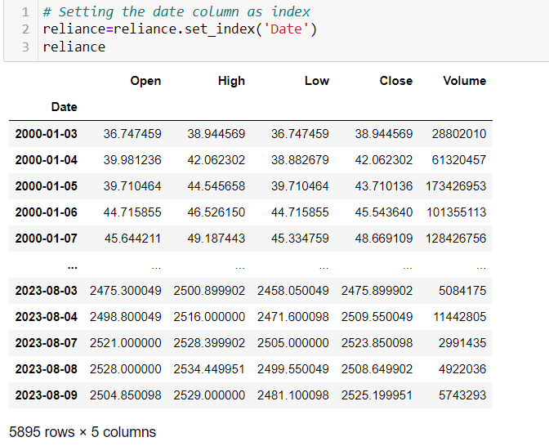
Exploratory data analysis (EDA) is used to analyze and investigate data sets and summarize their main characteristics, often employing data visualization methods.

Slide 9
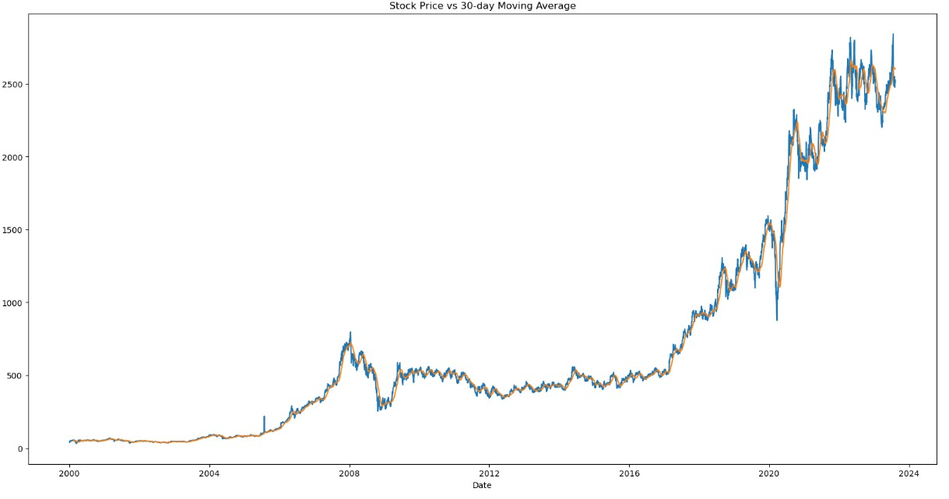
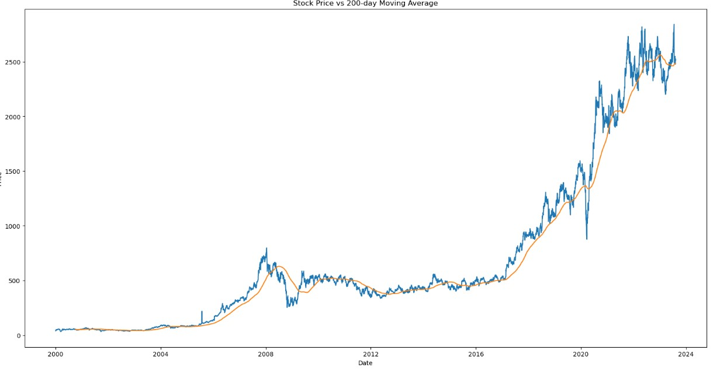
Long-term and short-term trends Moving Average

Slide 10
MODEL BUILDING

Slide 11
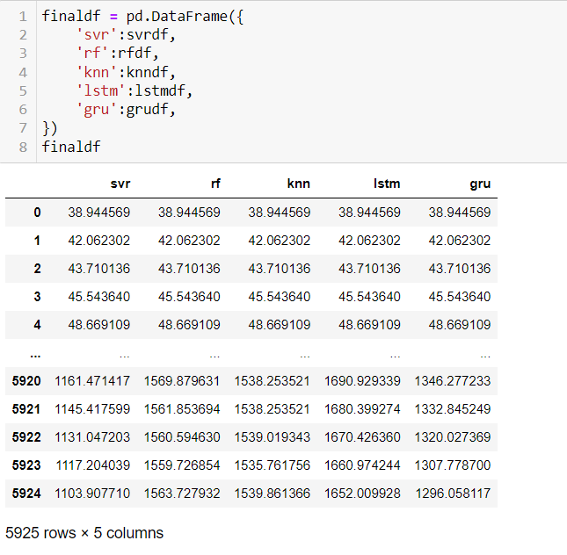
In this Model building, we used 5 different types of models
LSTM(Long short-term memory)
Random forest regressor
Support vector regression
KNN(k-nearest neighbors )
Gated Recurrent Unit

Slide 12
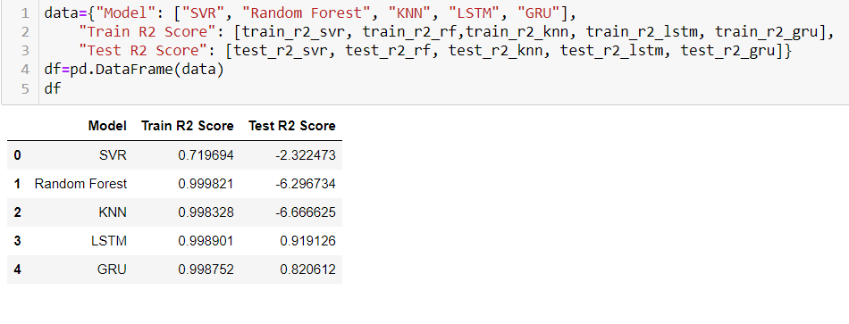
By Looking at this table we can say that our LSTM model has the best R2 score.
So we are going to use the LSTM model for our deployment part

Slide 13
DEPLOYMENT

Slide 14
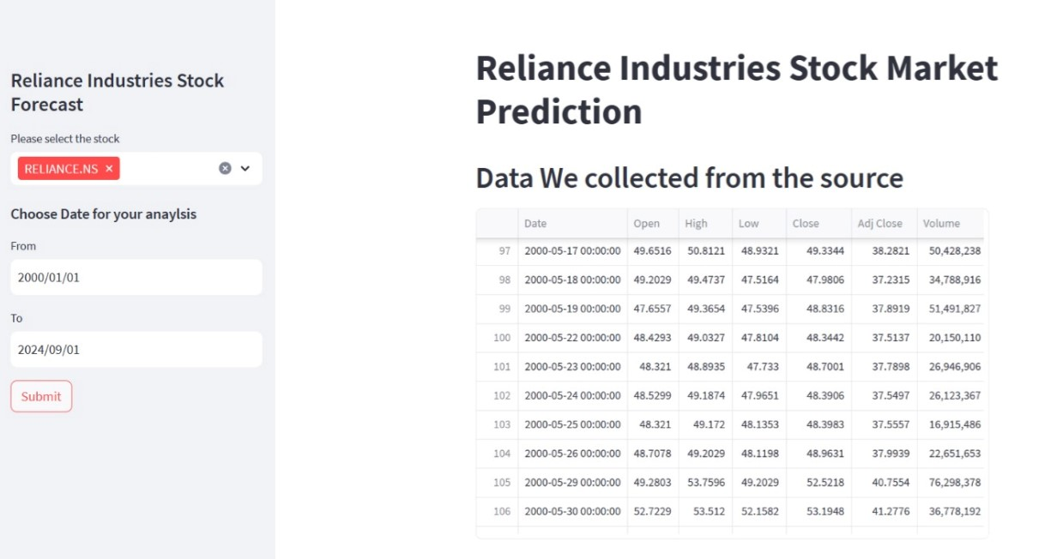
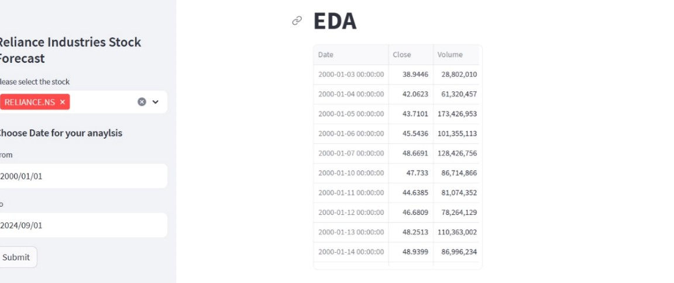

Slide 15
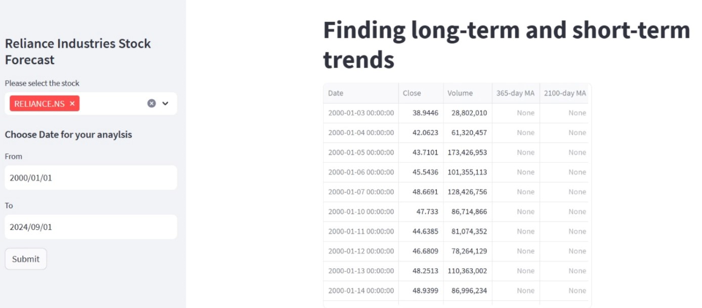
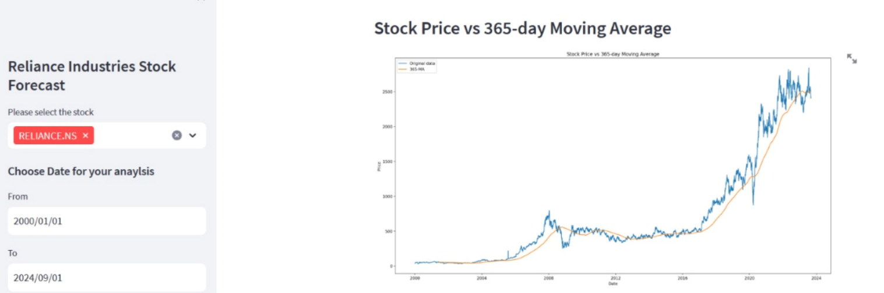

Slide 16
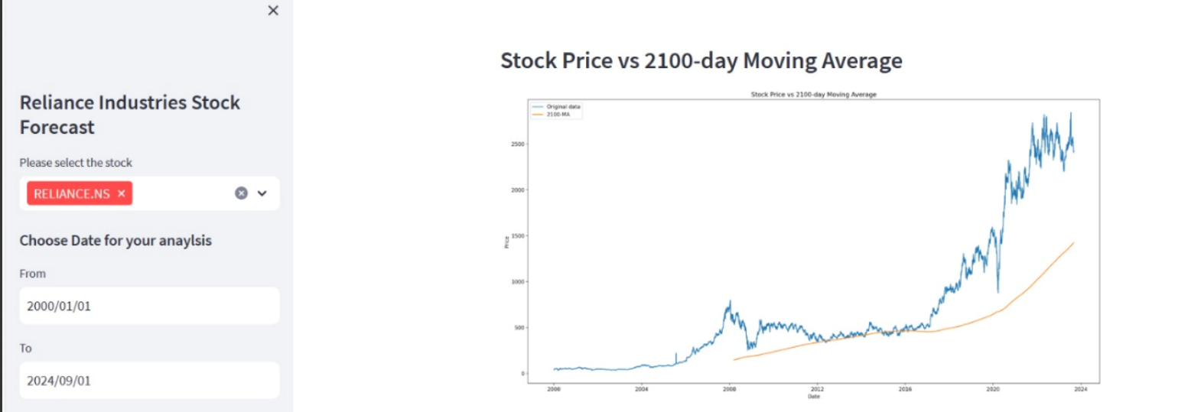
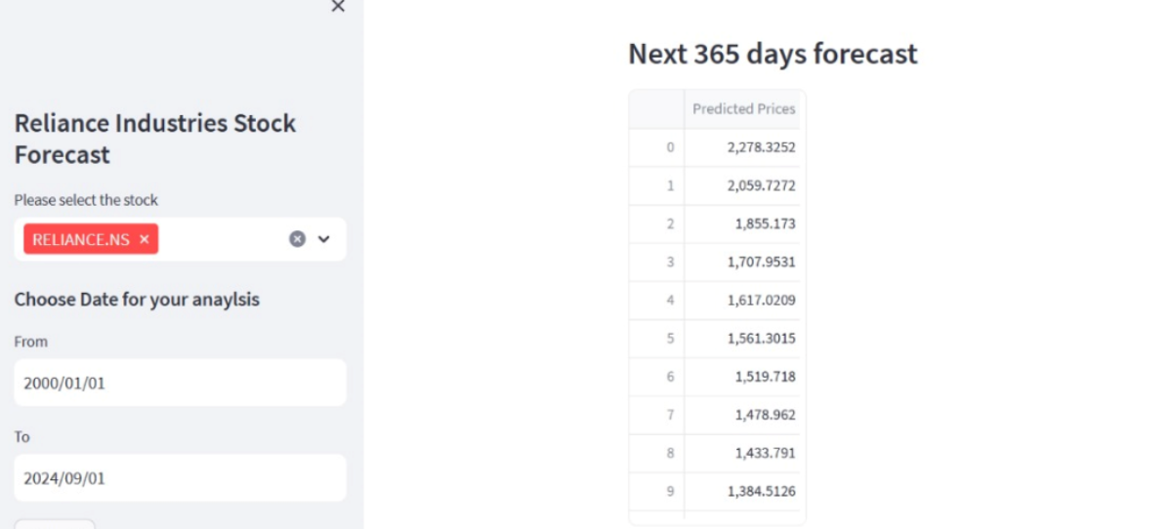

Slide 17
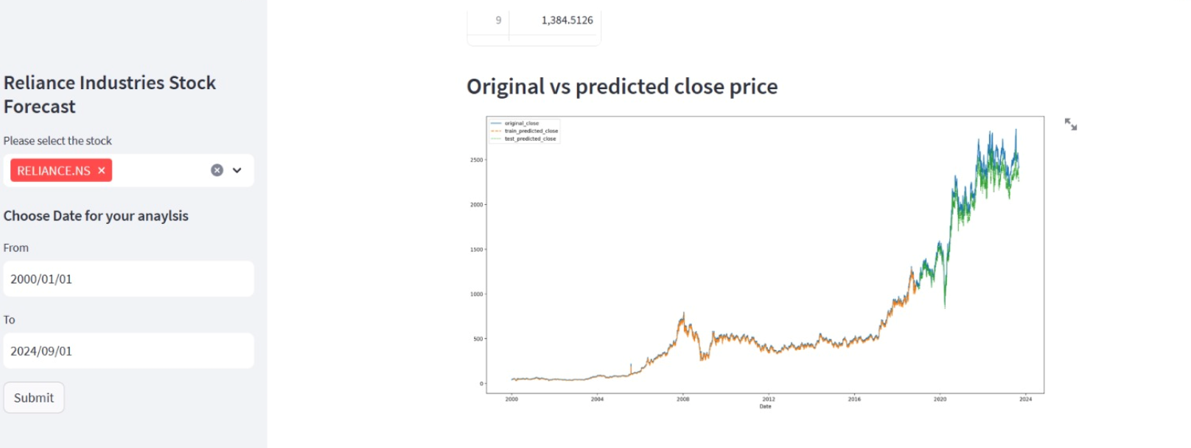

Slide 18
Challenges Faced?
Starting from the Data collection part, we got our data online from Yahoo Finance. EDA was also a smooth journey for us since the data was already cleaned and had no missing values. Coming towards the Model building, it was quite challenging for us to select which model to use for stock price prediction that would give us the highest accuracy.
How Did we overcome it?
While Model building, we tried our dataset on 5 different types of models (LSTM, Random forest regressor, Support vector regression, KNN, and Gated Recurrent Unit) out of which LSTM gave us the highest accuracy and best result. Therefore we finalized our LSTM model and Deployed it successfully using Visual Studio and Streamlit.

Slide 19
THANK YOU

